Slide 1
Digital Tools for Recruitment and Retention in RCTs:
Systematic Map Reveals State Of the Art, Strengths And Limitations
Geoff Frampton¹, Jonathan Shepherd¹, Karen Pickett¹,
Gareth Griffiths², Jeremy Wyatt³
¹ Southampton Health Technology Assessments Centre (SHTAC)
² Southampton Clinical Trials Unit
³ Wessex Institute, Faculty of Medicine, University of Southampton

Slide 2
Background – the project
Part of the NIHR-funded project “User-focused research to identify the benefits of innovative digital recruitment and retention tools for more efficient conduct of RCTs”
Systematic map to characterise the “state of the art” in digital tools research – this presentation
Qualitative analyses of the views and experiences of stakeholders, including trial investigators, participants and clinical trials units –
next presentation (Amanda Blatch-Jones and colleagues)

Slide 3
Background – the problem
● RCTs often fail to recruit adequate numbers of participants
● Once recruited, rates of participant dropout can be high
Inadequate statistical power
Inadequate follow-up
Research waste: time, costs
Personal time wasted (tens of thousands of patients/year)
Ethical issues
Delayed policy decisions

Slide 4
Background – potential solutions
Digital tools may improve recruitment and/or retention
…but first, what do we mean by “digital” tools?
Digital | Non-digital (traditional)
Computer, tablet, smartphone or other electronic gadget-based invitations or reminders; email; social media; automated phone calls; electronic adverts; automated screening of patient clinical records, disease registries or trial databases; automated communication of test results | Written materials e.g. flyers, posters letters; printed adverts; person-to-person phone calls; word of mouth; manual screening of patient clinical records, disease registries or trial databases; manual communication of test results
automated vs manual
electronic vs written/spoken

Slide 5
Background – potential solutions
Overall approaches that could be facilitated by digital and/or traditional tools
Recruitment
Retention
● Help to identify potential
participants for an RCT
● Remind participants to attend visits or
tests
● Help to identify potential RCTs
that an individual may join
● Prompt participants to provide
information
● Help health professionals to
match people to RCTs
● Information dissemination from RCT
investigators to participants
● Raise general awareness of one
or more RCTs
● Process for handling participant enquiries

Slide 6
Background – questions
Which digital tools have been used, for which types of RCT?
Recruitment
Retention
???
???
???

Slide 7
Our aims
● Identify research studies that have evaluated the effectiveness of digital tools for improving the recruitment and/or retention of participants in RCTs
● Describe the characteristics of:
the digital tools that have been evaluated
the studies that have evaluated them
State of the art, strengths and limitations, evidence hotspots and gaps for digital recruitment and retention tools

Slide 8
Our approach – Systematic mapping
What is a systematic map?

Slide 9
Our approach – Systematic mapping
 | Systematic map | Systematic review
Peer-reviewed protocol
Extensive literature searches
Pre-specified study selection process
Data extraction | Coding approach to allow cross-tabulation of key study characteristics | Tabulation of key study characteristics and factors affecting validity
Validity (bias) assessment | X
Data synthesis | Quantitatively and/or qualitatively describes characteristics of the studies based on the coded variables | Quantitatively and/or qualitatively estimates value and precision of an effect (e.g. meta-analysis)

Slide 10
Our approach – Systematic mapping
● Extensive literature searches of published and “grey” literature
● Study eligibility screening against pre-specified inclusion/exclusion criteria
● Systematic coding of studies to consistently record key features of interest
● Analysis and presentation of results
Overview of research study and digital tool characteristics, to identify: state of the art, strengths and limitations, and evidence gaps and hotspots
(mapping is not an evaluation of tool effectiveness, but provides an important foundation for this)

Slide 11
Inclusion criteria ( = scope of the map)
Question element | Systematic map inclusion criteria
Population | Any population relevant to recruitment or retention in health RCTs (e.g. health professionals, study investigators, patients, the public)
Intervention | At least one digital approach for patient recruitment and/or retention
Comparator | Non-digital approaches Alternative digital approaches
Outcomes | Any outcomes relevant to effectiveness or efficiency (e.g. rate, time, accuracy, costs)
Design | Study evaluating the digital approach: any design provided that the study assessed the effectiveness or accuracy of digital tools for recruitment and/or retention “Target RCT”: the health RCT for which participants are recruited/retained
Restrictions | Studies published in the last 10 years
Notes:
Agreed with advisory board and pilot-tested

Slide 12
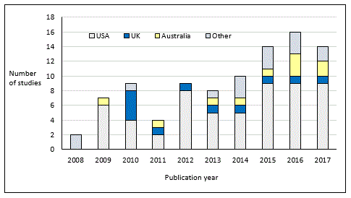
Results
Observational study or retrospective analysis 89%
Experimental study: randomised 7% , non-randomised 4%
9159 references identified in searches
Title + abstract screening
353 full-text articles retrieved
Full-text screening
100 articles reporting 101 studies included in the map

Slide 13
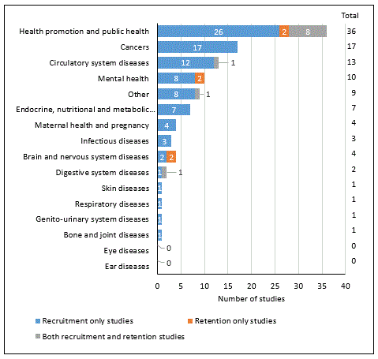
Health topics covered in
the target RCTs in studies of digital tools for
recruitment (blue bars), retention (orange bars)
or both (grey bars)

Slide 14
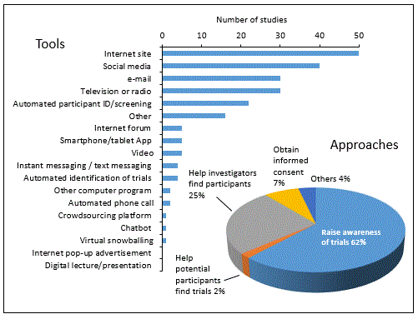
Digital tools and
approaches for recruitment

Slide 15
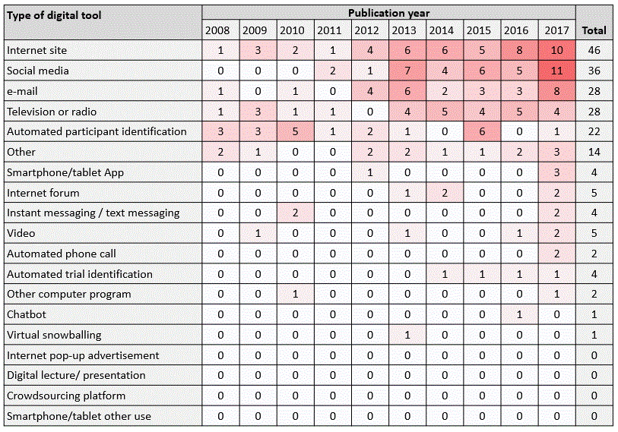
“Heat map” of digital recruitment tools by publication year
Results

Slide 16
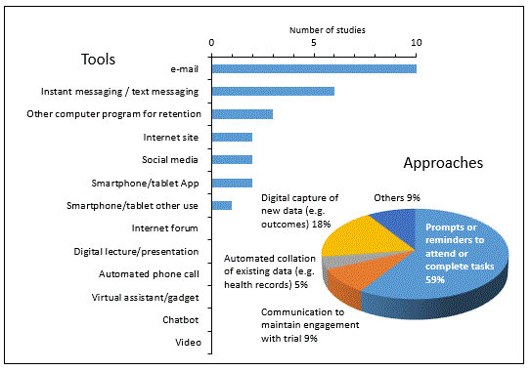
Results
Digital tools and
approaches for retention

Slide 17
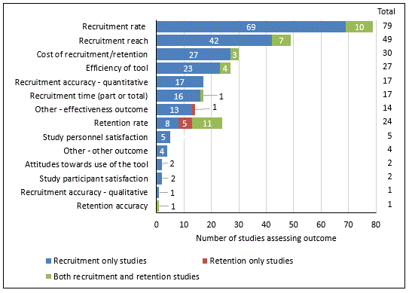
Outcomes reported in studies of recruitment
(blue bars), retention
(orange bars)
and both
(green bars)

Slide 18
Conclusions
● An active research area, but mostly observational studies
● The focus has been on recruitment, with far fewer studies on retention (why?)
● The most common digital recruitment approach was to publicise trials to potential
participants, using e.g. website, email, social media, TV
● The most common digital retention approach was prompts or reminders to
complete tasks, using e.g. email or text messaging
● Many studies used multiple digital tools, often in combination with non-digital tools
(e.g. leaflet, phone, letter)
● The most common outcome measure was recruitment rate; few studies assessed costs
● Few studies assessed the accuracy of identifying eligible participants
● Few studies assessed attitudes or other facilitators/barriers

Slide 19
Recommendations and questions
● More robust, experimental, studies are needed (perhaps as “Studies Within A Trial” – SWAT?)
● Routine assessment of facilitators/barriers would be helpful
● Can a core set of digital tools that optimise recruitment and retention be identified/developed?
● What are the priority health areas where we need these tools the most (does the map reflect
actual needs or research convenience?)
Next steps
● Publish the map (manuscript under review)
● Explore the issues raised above
● Develop the project website (next slide)
● Related research (next presentation)

Slide 20
Project website www.digitaltools.org.uk
Project funded by

